Slide 1
Data Streams

Slide 2
Data Streams
In many data mining situations, we do not know the entire data set in advance
Examples
Traffic condition at roads
Twitter timeline
CCTV footage
Search queries in google
Who called whom (this is a stream of edges in a network)
We can think of the data as infinite and non-stationary

Slide 3
The Stream Model
Input elements enter at a rapid rate, at one or more input ports (i.e., streams)
We call elements of the stream tuples
The system cannot store the entire stream accessibly
Q: How do you make critical calculations about the stream using a limited amount of (secondary) memory?

Slide 4
Problems on Data Streams
Sampling data from a stream
Construct a random sample
Filtering a data stream
Select elements with property x from the stream
Counting distinct elements
Number of distinct elements in the last k elements of the stream
Estimating moments
Estimate avg./std. dev. of last k elements
Finding frequent elements
Google wants to know what queries are more frequent today than yesterday

Slide 5
Sampling from a Data Stream
Two different problems:
(1) Sample a fixed proportion of elements in the stream (say 1 in 10)
(2) Maintain a random sample of fixed size over a potentially infinite stream
At any “time” k we would like a random sample of s elements
What is the property of the sample we want to maintain? For all time steps k, each of k elements seen so far has equal prob. of being sampled

Slide 6
Sampling a Fixed Proportion
Problem 1: Sampling fixed proportion
Scenario: Search engine query stream
Stream of tuples: (user, query, time)
Have space to store 1/10th of query stream
Simple question: What fraction of queries by an average search engine user are duplicates?
Suppose each user issues x queries once and d queries twice (total of x+2d queries)
Correct answer: d/(x+d)

Slide 7
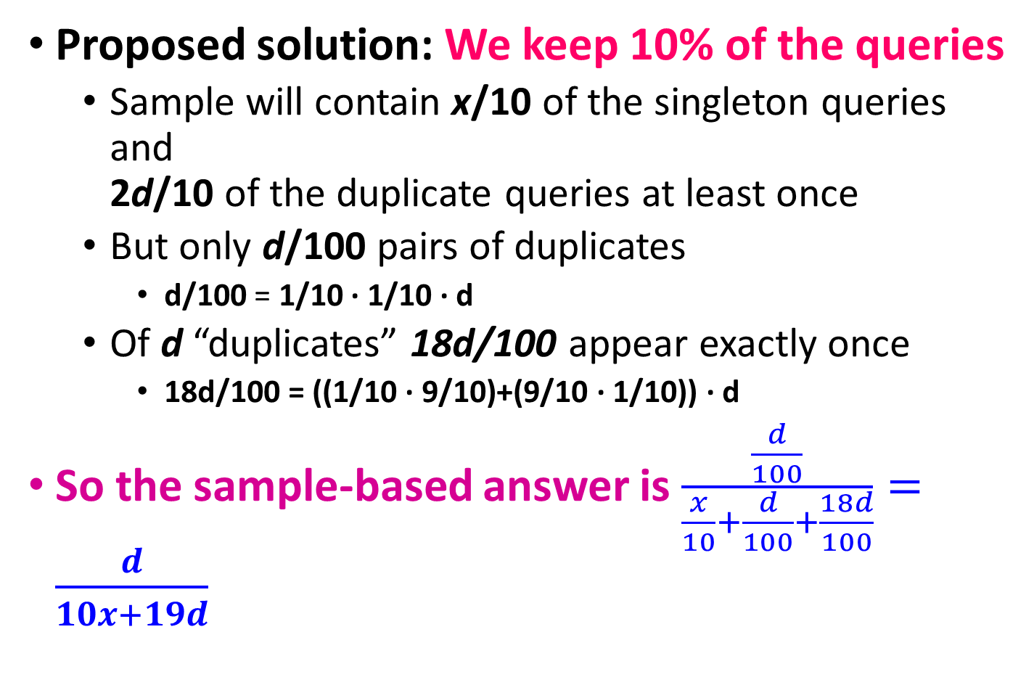
Naïve Approach
Proposed solution: We keep 10% of the queries
Sample will contain x/10 of the singleton queries and 2d/10 of the duplicate queries at least once
But only d/100 pairs of duplicates
d/100 = 1/10 ∙ 1/10 ∙ d
Of d “duplicates” 18d/100 appear exactly once
18d/100 = ((1/10 ∙ 9/10)+(9/10 ∙ 1/10)) ∙ d
So the sample-based answer is $\frac{\frac{d}{100}}{\frac{x}{10}+\frac{d}{100}+\frac{18d}{100}}=\frac{d}{10x+19d}$
Notes:
d/100 appear twitece: 1st query gets sampled with prob. 1/10, 2nd also with 1/10, there are d such queries: d/100
18d/100 appear once. 1/10 for first to get selection and 9/10 for the second to not get selected. And the other way around so 18d/100

Slide 8
Solution: Sample Users
Solution:
Pick 1/10th of users and take all their searches in the sample
Use a hash function that hashes the user name or user id uniformly into 10 buckets

Slide 9
Maintaining a fixed-size sample
Problem: Fixed-size sample
Suppose we need to maintain a random sample S of size exactly s tuples
E.g., main memory size constraint
Suppose at time n we have seen n items
Each item is in the sample S with equal prob. s/n
How to think about the problem: say s = 2
Stream: a x c y z k c d e g…
At n= 5, each of the first 5 tuples is included in the sample S with equal prob.
At n= 7, each of the first 7 tuples is included in the sample S with equal prob.
Impractical solution would be to store all the n tuples seen so far and out of them pick s at random

Slide 10
Solution: Fixed Size Sample
Algorithm (a.k.a. Reservoir Sampling)
Store all the first s elements of the stream to S
Suppose we have seen n-1 elements, and now the n^{th} element arrives (n > s)
With probability s/n, keep the n^{th} element, else discard it
If we picked the n^{th} element, then it replaces one of the s elements in the sample S, picked uniformly at random
Claim: This algorithm maintains a sample S with the desired property:
After n elements, the sample contains each element seen so far with probability s/n

Slide 11
Proof: By Induction
We prove this by induction:
Assume that after n elements, the sample contains each element seen so far with probability s/n
We need to show that after seeing element n+1 the sample maintains the property
Sample contains each element seen so far with probability s/(n+1)
Base case:
After we see n=s elements the sample S has the desired property
Each out of n=s elements is in the sample with probability s/s = 1

Slide 12
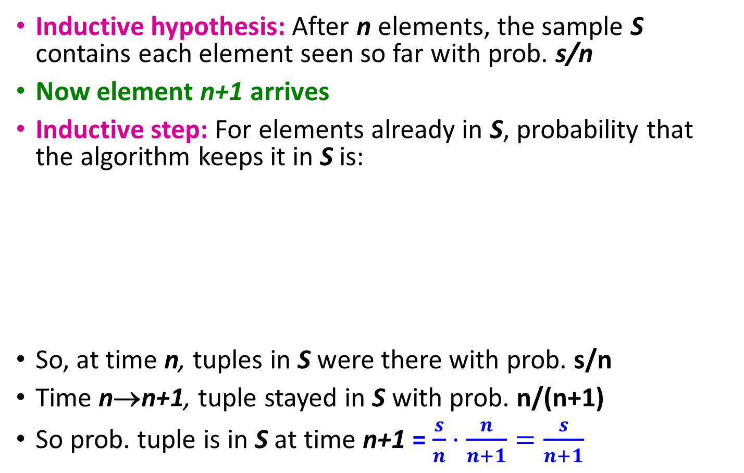
Proof: By Induction
Inductive hypothesis: After n elements, the sample S contains each element seen so far with prob. s/n
Now element n+1 arrives
Inductive step: For elements already in S, probability that the algorithm keeps it in S is:
So, at time n, tuples in S were there with prob. s/n
Time n→n+1, tuple stayed in S with prob. n/(n+1)
So prob. tuple is in S at time n+1 = $\frac{s}{n}⋅\frac{n}{n+1}=\frac{s}{n+1}$
Element n+1 discarded
Element n+1 not discarded
Element in the sample not picked

Slide 13
Filtering Data Streams
Each element of data stream is a tuple
Given a list of keys S
Determine which tuples of stream are in S
S is really large and cannot be stored in memory
Example: Email spam filtering
We know 1 billion “good” email addresses
If an email comes from one of these, it is NOT spam

Slide 14
First Cut Solution (1)
Given a set of keys S that we want to filter
Create a bit array B of n bits, initially all 0s
Based on main-memory budget
Example: 8 billion bits=1GB
Choose a hash function h with range [0,n)
Hash each member of s∈ S to one of n buckets, and set that bit to 1, i.e., B[h(s)]=1
Hash each element a of the stream and output only those that hash to bit that was set to 1
Output a if B[h(a)] == 1

Slide 15
First Cut Solution (2)
Output the item since it may be in S.
Item hashes to a bucket that at least one of the items in S hashed to.
Filter
Item
Hash func h
0010001011000
Bit array B
Drop the item.
It hashes to a bucket set to 0 so it is surely not in S.
Creates false positives but no false negatives
If the item is in S we surely output it, if not we may still output it

Slide 16
False Positive Rate
|S| = 1 billion email addresses |B|= 1GB = 8 billion bits
If the email address is in S, then it surely hashes to a bucket that has the bit set to 1, so it always gets through (no false negatives)
What is the false positive rate?

Slide 17
Analysis: False Positive rate
Consider: If we throw m darts into n equally likely targets, what is the probability that a target gets at least one dart?
In our case:
Targets = bits/buckets
Darts = hash values of items

Slide 18

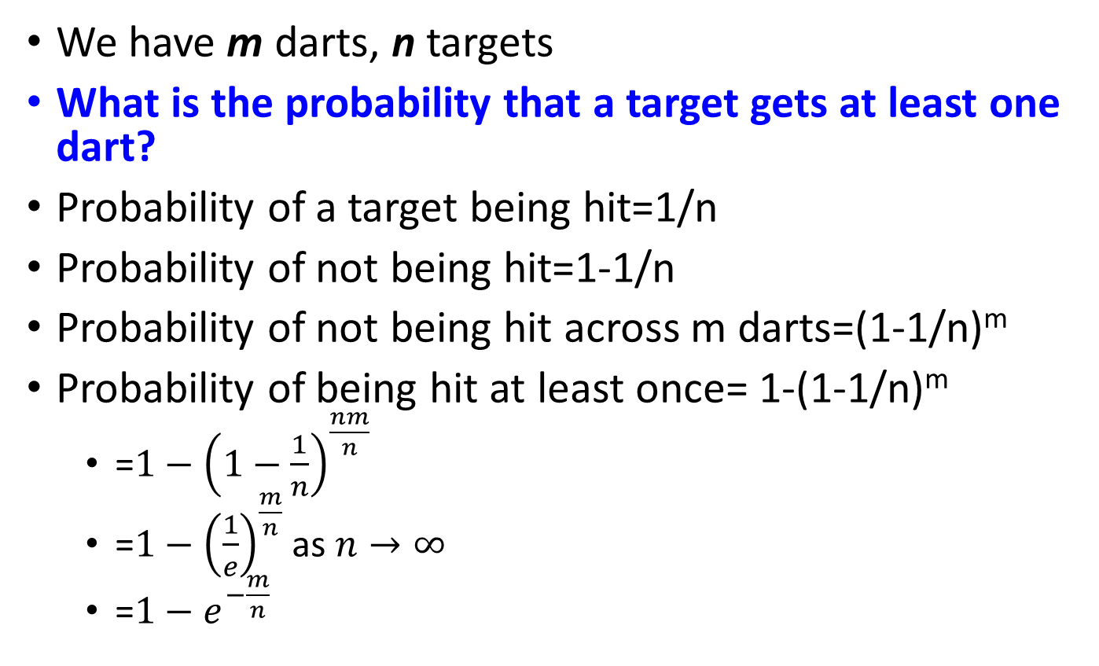
Analysis: Throwing Darts (2)
We have m darts, n targets
What is the probability that a target gets at least one dart?
Probability of a target being hit=1/n
Probability of not being hit=1-1/n
Probability of not being hit across m darts=(1-1/n)^{m}
Probability of being hit at least once= 1-(1-1/n)^{m}
=$1−{\left(1−\frac{1}{n}\right)}^{\frac{nm}{n}}$
=$1−{\left(\frac{1}{e}\right)}^{\frac{m}{n}}$ as $n→∞$
=$1−e^{−\frac{m}{n}}$

Slide 19
Analysis: Throwing Darts (3)
Fraction of 1s in the array B = = probability of false positive = 1 – e^{-m/n}
|S| = 1 billion email addresses |B|= 1GB = 8 billion bits
Example: 10⁹ darts, 8∙10⁹ targets
Fraction of 1s in B = 1 – e^{-1/8} = 0.1175
10% is pretty high. Can we improve?

Slide 20
Bloom Filter
Consider: |S| = m, |B| = n
Use k independent hash functions h₁ ,…, h_{k}
Initialization:
Set B to all 0s
Hash each element s∈ S using each hash function h_{i}, set B[h_{i}(s)] = 1 (for each i = 1,.., k)
Run-time:
When a stream element with key x arrives
If B[h_{i}(x)] = 1 for all i = 1,..., k then declare that x is in S
That is, x hashes to a bucket set to 1 for every hash function h_{i}(x)
Otherwise discard the element x
(note: we have a single array B!)

Slide 21
Bloom Filter -- Analysis
What fraction of the bit vector B are 1s?
Throwing k∙m darts at n targets
So fraction of 1s is (1 – e^{-km/n})
But we have k independent hash functions and we only let the element x through if all k hash element x to a bucket of value 1
So, false positive probability = (1 – e^{-km/n})^{k}
m = 1 billion, n = 8 billion
k = 1: (1 – e^{-1/8}) = 0.1175
k = 2: (1 – e^{-1/4})² = 0.0493

Slide 22
Counting Distinct Elements
Problem:
Data stream consists of a universe of elements chosen from a set of size N
Maintain a count of the number of distinct elements seen so far
Obvious approach: Maintain the set of elements seen so far
That is, keep a hash table of all the distinct elements seen so far

Slide 23
Applications
How many different words are found among the Web pages being crawled at a site?
Unusually low or high numbers could indicate artificial pages (spam?)
How many users are not dormant in Facebook or Twitter?
How many distinct products have we sold in the last week?

Slide 24
Using Small Storage
Real problem: What if we do not have space to maintain the set of elements seen so far?
Estimate the count in an unbiased way
Accept that the count may have a little error, but limit the probability that the error is large

Slide 25
Flajolet-Martin Approach
Pick a hash function h that maps each of the N elements to log₂ N bits
For each stream element a, let r(a) be the number of trailing 0s in h(a)
r(a) = position of first 1 counting from the right
E.g., say h(a) = 12, then 12 is 1100 in binary, so r(a) = 2
Record R = the maximum r(a) seen
R = max_{a} r(a), over all the items a seen so far
Estimated number of distinct elements = 2^{R}

Slide 26
Why It Works: Intuition
Very very rough and heuristic intuition why Flajolet-Martin works:
h(a) hashes a with equal prob. to any of N values
Then h(a) is a sequence of log₂ N bits, where 2^{-r} fraction of all as have a tail of r zeros
About 50% of as hash to ***0
About 25% of as hash to **00
So, if we saw the longest tail of r=2 (i.e., item hash ending *100) then we have probably seen about 4 distinct items so far
So, it takes to hash about 2^{r} items before we see one with zero-suffix of length r

Slide 27
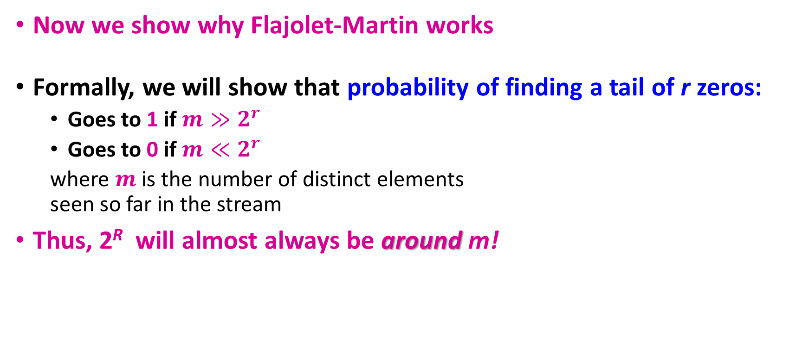
Why It Works: More formally
Now we show why Flajolet-Martin works
Formally, we will show that probability of finding a tail of r zeros:
Goes to 1 if $m≫2^{r}$
Goes to 0 if $m≪2^{r}$
where $m$ is the number of distinct elements seen so far in the stream
Thus, 2^{R} will almost always be around m!

Slide 28

Why It Works: More formally
Probability of a tail of length r: 2^{-r}
Then, the probability of NOT seeing a tail of length r among m elements:
$${\left(1−2^{−r}\right)}^{m}$$
Prob. all end in fewer than r zeros.
Prob. that given h(a) ends in fewer than r zeros

Slide 29
Why It Works: More formally
Prob. of NOT finding a tail of length r is:
If m << 2^{r}, then prob. tends to 1
as m/2^{r}→ 0
So, the probability of finding a tail of length r tends to 0
If m >> 2^{r}, then prob. tends to 0
as m/2^{r} → ∞
So, the probability of finding a tail of length r tends to 1
Thus, 2^{R} will almost always be around m!
Notes:
If 2^r approaches infinity, then we have (1/e)^(m/2^r). if m<<2^r then (1/e)^0=1
if m>>2^r and 2^r is not approaching infinity, then we have (1-1/2^r)^(2^r*m/2^r)=k^(m/2^r), where k<1/e<1. Since m>>2^r, k^(m/2^r)=0

Slide 30
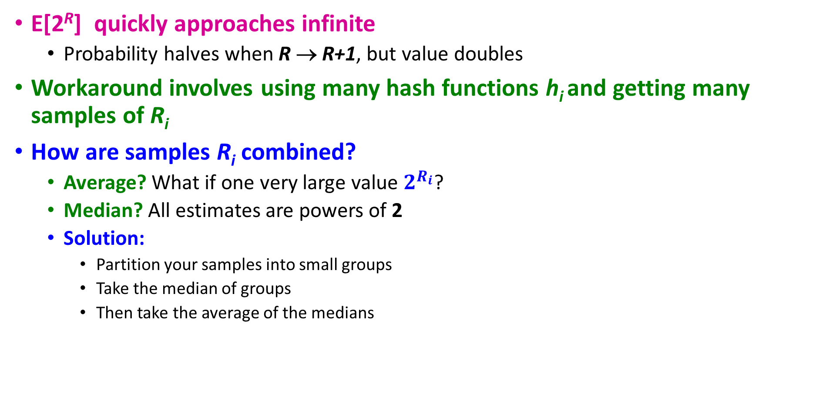
Why It Doesn’t Work
E[2^{R}] quickly approaches infinite
Probability halves when R → R+1, but value doubles
Workaround involves using many hash functions h_{i} and getting many samples of R_{i}
How are samples R_{i} combined?
Average? What if one very large value $2^{R_{i}}$?
Median? All estimates are powers of 2
Solution:
Partition your samples into small groups
Take the median of groups
Then take the average of the medians

Slide 31
Top-k/Range query on frequent elements
Given alphabet A, stream S of size N, a frequent element, E, is an element whose frequency, F, exceeds a user specified support, φN
Top-k elements are the k elements with highest frequency
Exact solution space complexity?
O(min(N,A)) space
“Efficient Computation of Frequent and Top-k Elements in Data Streams” by Ahmed Metwally, Divyakant Agrawal, and Amr El Abbadi, ICDT 2005.

Slide 32
Space-Saving By Example
Element
Count
error (max possible)
Element | B | E | C
Count | 5 | 4 | 4
error (max possible) | 0 | 3 | 3
A
B
B
A
C
A
B
B
D
D
B
E
C
Space-Saving Algorithm
For every element in the stream S
If a monitored element is observed
Increment its Count
If a non-monitored element is observed,
Replace the element with minimum hits, min
Increment the minimum Count to min + 1
maximum possible over-estimation is error
Space-Saving Algorithm
For every element in the stream S
If a monitored element is observed
Increment its Count
If a non-monitored element is observed,
Replace the element with minimum hits, min
Increment the minimum Count to min + 1
maximum possible over-estimation is error
Space-Saving Algorithm
For every element in the stream S
If a monitored element is observed
Increment its Count
If a non-monitored element is observed,
Replace the element with minimum hits, min
Increment the minimum Count to min + 1
maximum possible over-estimation is error
Space-Saving Algorithm
For every element in the stream S
If a monitored element is observed
Increment its Count
If a non-monitored element is observed,
Replace the element with minimum hits, min
Increment the minimum Count to min + 1
maximum possible over-estimation is error
Space-Saving Algorithm
For every element in the stream S
If a monitored element is observed
Increment its Count
If a non-monitored element is observed,
Replace the element with minimum hits, min
Increment the minimum Count to min + 1
maximum possible over-estimation is error

Slide 33
Space-Saving Observations
S = ABBACABBDDBEC N = 13
Observations:
The summation of the Counts is N
Minimum number of hits, min ≤ N/m
In this example, min = 4
The minimum number of hits, min, is an upper bound on the error of any element
Element | B | E | C
Count | 5 | 4 | 4
error (max possible) | 0 | 3 | 3
Element | B | E | C
Count | 5 | 4 | 4
error (max possible) | 0 | 3 | 3
Element | B | E | C
Count | 5 | 4 | 4
error (max possible) | 0 | 3 | 3

Slide 34
Space-Saving Proved Properties
What can we say about the accuracy of top-k items?
If Element E has frequency F > min ?
then E must be in Stream-Summary. F(B) = F₁ = 5, min = 4.
How about the accuracy of the counts?
The Count at position i in Stream-Summary is no less than F_{i}, the frequency of the i^{th} ranked element.
The counts are upper bounds
Element | B | E | C
Count | 5 | 4 | 4
error (max possible) | 0 | 3 | 3
Notes:
Property 2 is important to guarantee the correctness and order of top-k.

Slide 35
Frequent Elements Queries
Traverse Stream-Summary, and report all elements that satisfy the user support
Any element whose
guaranteed hits = (Count – error) > φN
is guaranteed to be a frequent element

Slide 36
Frequent Elements Example
Element | B | D | G | A | Q | F | C | E
Count | 20 | 14 | 12 | 9 | 7 | 5 | 3 | 3
error | 1 | 0 | 4 | 1 | 3 | 0 | 1 | 2
Guaranteed Hits = Count - error | 19 | 14 | 8 | 8 | 4 | 5 | 2 | 1
Element | B | D | G | A | Q | F | C | E
Count | 20 | 14 | 12 | 9 | 7 | 5 | 3 | 3
error | 1 | 0 | 4 | 1 | 3 | 0 | 1 | 2
Guaranteed Hits = Count - error | 19 | 14 | 8 | 8 | 4 | 5 | 2 | 1
For N = 73, m = 8, φ = 0.15:
Frequent Elements should have support of 11 hits.
Candidate Frequent Elements are B, D, and G.
Guaranteed Frequent Elements are B, and D, since their guaranteed hits > 11.

Slide 37
Top-k Elements Queries
Traverse the Stream-Summary, and report top-k elements.
Guaranteed top-k elements:
Any element whose guaranteed hits = (Count – error) ≥ Count_{k+1}, is guaranteed to be in the top-k.
Guaranteed top-k’ (where k’≈k):
The top-k’ elements reported are guaranteed to be the correct top-k’ iff for every element in the top-k’, guaranteed hits = (Count – error) ≥ Count_{k’+1}.

Slide 38
Top-k Elements Example
Element | B | D | G | A | Q | F | C | E
Count | 20 | 14 | 12 | 9 | 7 | 5 | 3 | 3
error | 1 | 0 | 4 | 1 | 3 | 0 | 1 | 2
Guaranteed Hits = Count - error | 19 | 14 | 8 | 8 | 4 | 5 | 2 | 1
Element | B | D | G | A | Q | F | C | E
Count | 20 | 14 | 12 | 9 | 7 | 5 | 3 | 3
error | 1 | 0 | 4 | 1 | 3 | 0 | 1 | 2
Guaranteed Hits = Count - error | 19 | 14 | 8 | 8 | 4 | 5 | 2 | 1
Element | B | D | G | A | Q | F | C | E
Count | 20 | 14 | 12 | 9 | 7 | 5 | 3 | 3
error | 1 | 0 | 4 | 1 | 3 | 0 | 1 | 2
Guaranteed Hits = Count - error | 19 | 14 | 8 | 8 | 4 | 5 | 2 | 1
Element | B | D | G | A | Q | F | C | E
Count | 20 | 14 | 12 | 9 | 7 | 5 | 3 | 3
error | 1 | 0 | 4 | 1 | 3 | 0 | 1 | 2
Guaranteed Hits = Count - error | 19 | 14 | 8 | 8 | 4 | 5 | 2 | 1
For k = 3, m = 8:
B, and D are guaranteed to be in the top-3.
B , D, G and A are guaranteed to be the top-4. Here k’ = 4.
B , and D are guaranteed to be the top-2. Another k’ = 2.

Slide 39
When would it work or not work?
Works: Power law
Makes use of the skewed property of the data
A minority of the elements, the more frequent ones, gets the majority of the hits.
Frequent elements will reside in the counters of bigger values.
They will not be distorted by the ineffective hits of the infrequent elements.
Numerous infrequent elements reside on the smaller counters.
Worst Case:
Relatively uniform

Slide 40
Counting Bits
Problem:
Given a stream of 0s and 1s
How many 1s are in the last N bits?
Obvious solution: Store the most recent N bits
When new bit comes in, discard the N+1st bit
0 1 0 0 1 1 0 1 1 1 0 1 0 1 0 1 1 0 1 1 0 1 1 0
Suppose N=6
Past Future

Slide 41
Counting Bits (2)
You can not get an exact answer without storing the entire window
Real Problem: What if we cannot afford to store N bits?
E.g., we’re processing 1 billion streams and N = 1 trillion
But we are happy with an approximate answer
0 1 0 0 1 1 0 1 1 1 0 1 0 1 0 1 1 0 1 1 0 1 1 0
Past Future

Slide 42
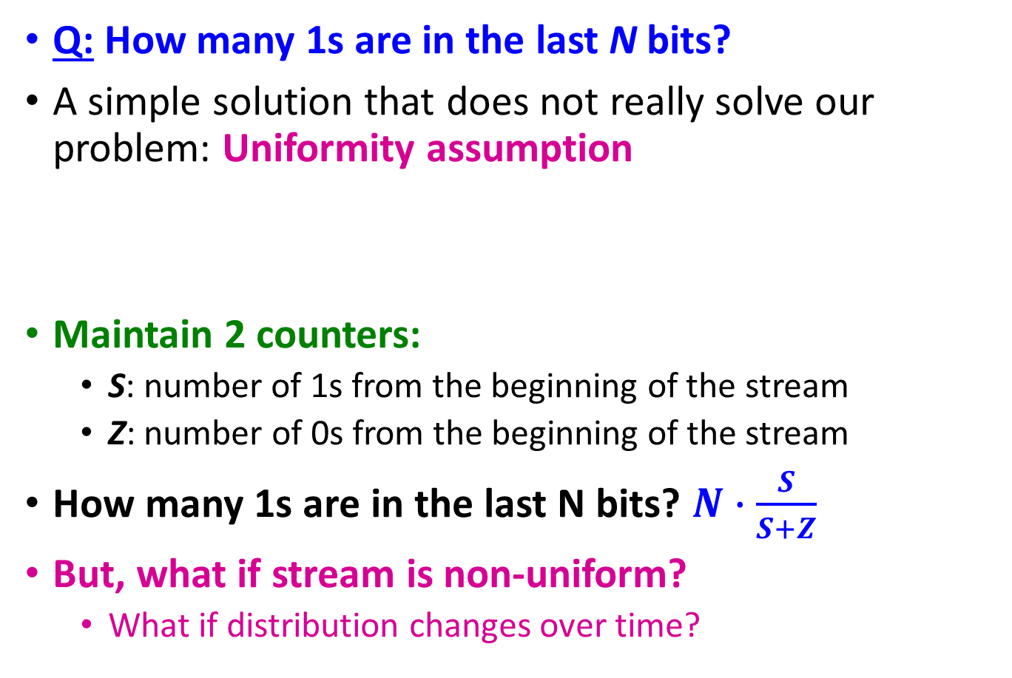
An attempt: Simple solution
Q: How many 1s are in the last N bits?
A simple solution that does not really solve our problem: Uniformity assumption
Maintain 2 counters:
S: number of 1s from the beginning of the stream
Z: number of 0s from the beginning of the stream
How many 1s are in the last N bits? $N∙\frac{S}{S+Z}$
But, what if stream is non-uniform?
What if distribution changes over time?
N
0 1 0 0 1 1 1 0 0 0 1 0 1 0 0 1 0 0 0 1 0 1 1 0 1 1 0 1 1 1 0 0 1 0 1 0 1 1 0 0 1 1 0 1 0
Past Future

Slide 43
DGIM method
Idea: Instead of summarizing fixed-length blocks, summarize blocks with specific number of 1s:
Let the block sizes (number of 1s) increase exponentially
Each bit in the stream has a timestamp, starting 1, 2, …
1001010110001011010101010101011010101010101110101010111010100010110010
N

Slide 44
Example: Bucketized Stream
At least 1 of
size 16. Partially
beyond window.
2 of
size 8
2 of
size 4
1 of
size 2
2 of
size 1
1001010110001011010101010101011010101010101110101010111010100010110010
N
Properties of buckets that are maintained:
Either one or two buckets with the same power-of-2 number of 1s
Buckets do not overlap in timestamps
Buckets are sorted by size
Buckets disappear when their end-time is > N time units in the past

Slide 45
DGIM: Buckets
A bucket in the DGIM method is a record consisting of:
(A) The timestamp of its end
(B) The number of 1s between its beginning and end
Storage
O(log²N)
1001010110001011010101010101011010101010101110101010111010100010110010
N

Slide 46
Example: Updating Buckets
Current state of the stream:
1001010110001011010101010101011010101010101110101010111010100010110010
Bit of value 1 arrives
0010101100010110101010101010110101010101011101010101110101000101100101
Two blue buckets get merged into a yellow bucket
0010101100010110101010101010110101010101011101010101110101000101100101
Next bit 1 arrives, new blue bucket is created, then 0 comes, then 1:
0101100010110101010101010110101010101011101010101110101000101100101101
Buckets get merged…
0101100010110101010101010110101010101011101010101110101000101100101101
State of the buckets after merging
0101100010110101010101010110101010101011101010101110101000101100101101

Slide 47
Updating Buckets (1)
When a new bit comes in, drop the last (oldest) bucket if its end-time is prior to N time units before the current time
2 cases: Current bit is 0 or 1
If the current bit is 0: no other changes are needed

Slide 48
Updating Buckets (2)
If the current bit is 1:
(1) Create a new bucket of size 1, for just this bit
End timestamp = current time
(2) If there are now three buckets of size 1, combine the oldest two into a bucket of size 2
(3) If there are now three buckets of size 2, combine the oldest two into a bucket of size 4
(4) And so on …

Slide 49
How to Query?
To estimate the number of 1s in the most recent N bits:
Sum the sizes of all buckets but the last
(note “size” means the number of 1s in the bucket)
Add half the size of the last bucket
Remember: We do not know how many 1s of the last bucket are still within the wanted window

Slide 50
Example: Bucketized Stream
At least 1 of
size 16. Partially
beyond window.
2 of
size 8
2 of
size 4
1 of
size 2
2 of
size 1
1001010110001011010101010101011010101010101110101010111010100010110010
N

Slide 51
Error Bound: Proof
Why is error 50%? Let’s prove it!
Suppose the last bucket has size 2^{r}
Then by assuming 2^{r-1} (i.e., half) of its 1s are still within the window, we make an error of at most 2^{r-1}
Since there is at least one bucket of each of the sizes less than 2^{r}, the true sum is at least 1 + 2 + 4 + .. + 2^{r-1} = 2^{r} -1
Thus, error at most 50%
At least 16 1s
111111110000000011101010101011010101010101110101010111010100010110010
N

